Slide 1
Promoting the Innovation Capacity of Higher Education in Nursing during Health Services’ Transition – ProInCa
Alma Syzdykova
«University Medical Center» CF / Nazarbayev University
Astana, Kazakhstan

Slide 2
About ProInCa
Promoting the Innovation Capacity of Higher Education in Nursing during Health Services’ Transition – ProInCa:
The project is co-funded by the Erasmus+ Capacity Building in the Field of Higher Education programme with a total grant of 947 983€.
ProInCa consortium consists of European and Kazakhstan HEIs and associated partners representing a variety of different stakeholders.
The project is led by JAMK University of Applied Sciences (Finland).
Duration of the project – 3 years.

Slide 3
ProInCa objectives
WIDER OBJECTIVE:
Developing the sustainable innovation capacity of Kazakhstan’s Medical Universities for the modernization of nursing.
Specific objectives:
Development of mechanisms for collaboration and knowledge sharing between academic national and international nursing community and society.
Learning best practices on implementing evidence-based nursing in nursing research, education and practice to promote the efficiency and quality of healthcare
Strengthen higher education institutions’ role in building evidence-based nursing research activities in health services to promote quality and safety of healthcare system.
Promote the capacity and system of nursing leadership and management in healthcare transition to improve the quality of healthcare system.

Slide 4
ProInCa consortium
Partners HEI’s
Associated partners
JAMK University of Applies Sciences (Finland), coordinator
Astana Medical University (Kazakhstan)
Angela Boskin Faculty of Health Care (Slovenia)
Karaganda State Medical University (Kazakhstan)
Lahti University of Applied Sciences (Finland)
Nazarbayev University (Kazakhstan)
Semey State Medical University (Kazakhstan)
Hanze University of Applied Sciences (Netherlands)
West-Kazakhstan Marat Ospanov State Medical University (Kazakhstan)
Republican Center for Health Development, Astana
JSC "Railway hospitals of disaster medicine”, Astana
Republican Public Association "Specialists of Nursing "Paryz"Public Association, Astana
Polyclinic # 1, Karaganda
Ekibastuz Medical College, Ekibastuz
Temirtau Medical College, temirtau
Nursing Research Foundation, Hotus, Helsinki
UMCG Health Facility, Groningen
"Turkestan" Multy-Speciality High Medical College, Turkestan
"High medical college" akimat of Astana city, Astana
State-owned public enterprise ”Emergency care hospital”, Aktobe
West Kazakhstan Higher Medical College, Uralsk
Semey state municipal hospital #2, Semey

Slide 5
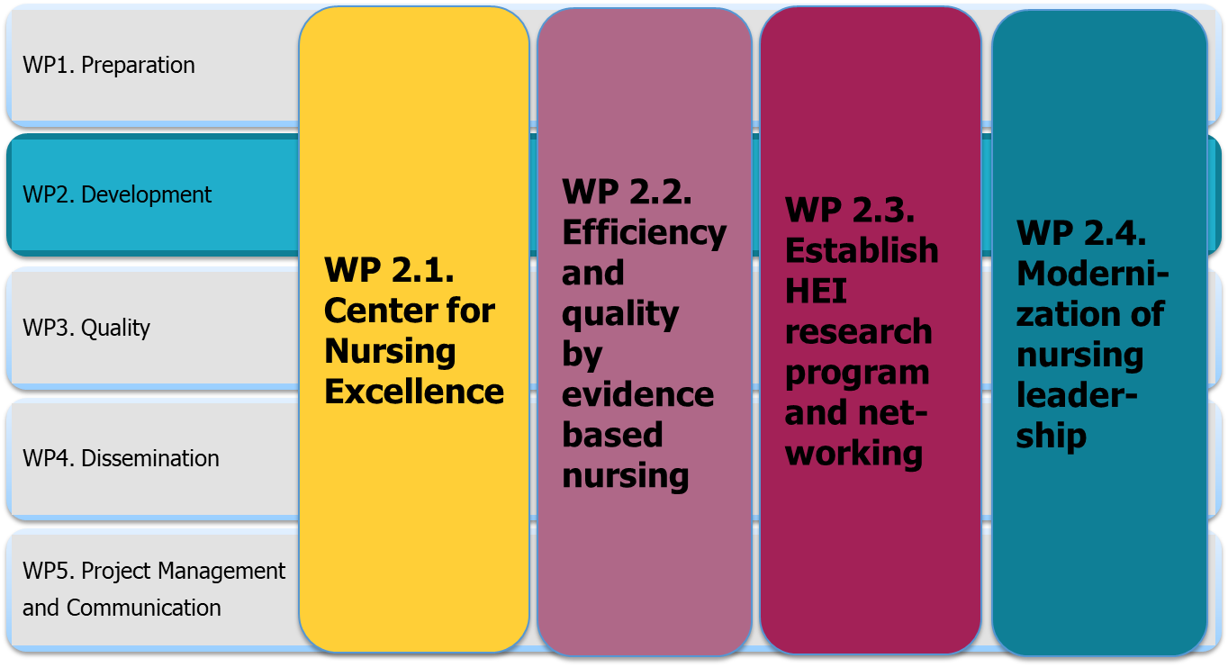
ProInCa structure

Slide 6
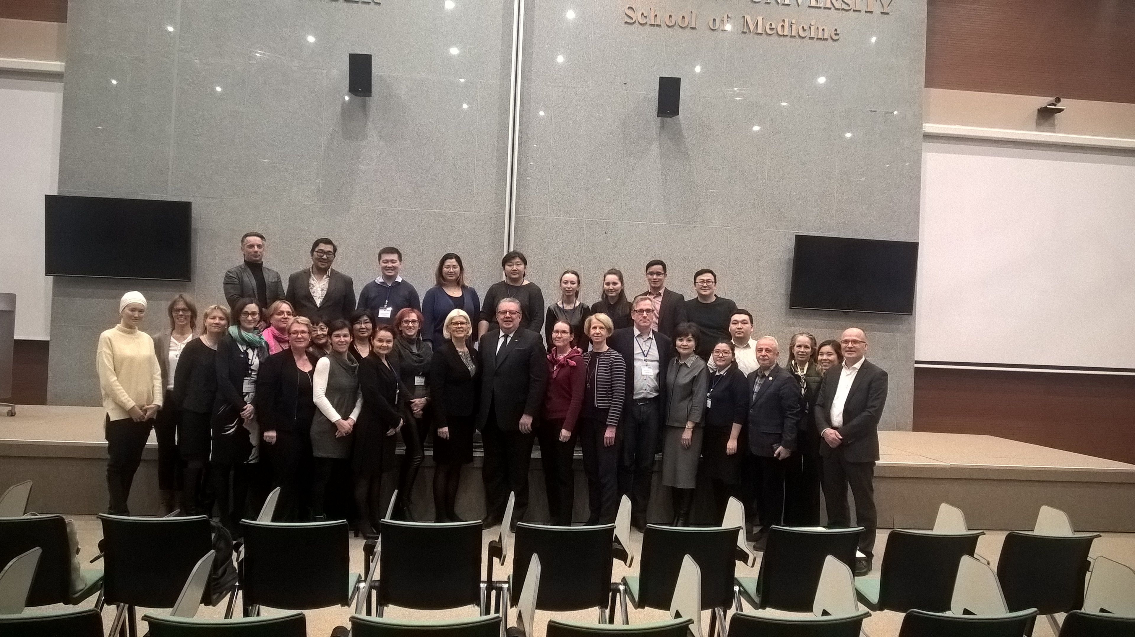
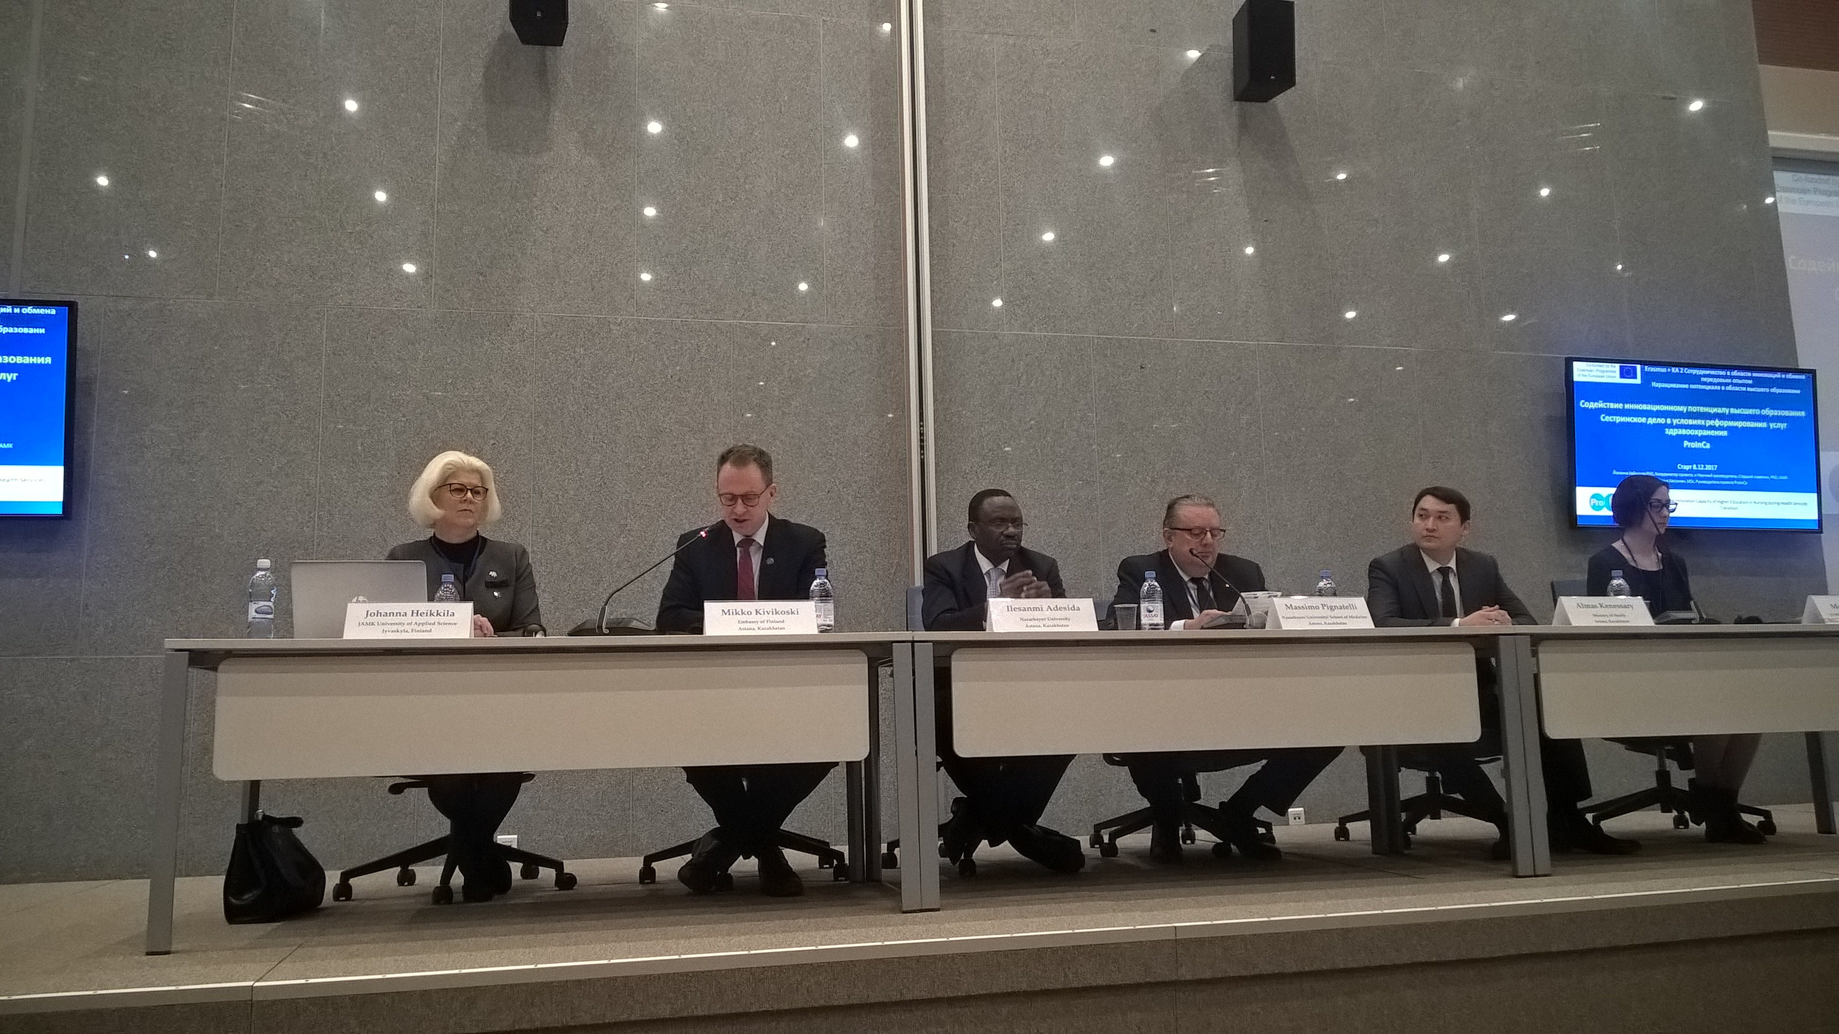
Kick-off meeting in Astana, Kazakhstan
December 7-9, 2017 in Astana at Nazarbayev University there was conducted
the first Kick-off meeting for project participants and associated partners.
The main goal of the meeting – to network
and write down the concrete steps for the development of future work.

Slide 7
WP 2.1. Center for Nursing Excellence
Objective: Creation of the structure that accumulate, develop and disseminate the best international and domestic experience based on evidences in the field of nursing education, science and practice
development of mechanisms for collaboration and knowledge sharing between academic national and international nursing communities (universities and other institutions) and society
creation of e-platform, national and international networks and working groups
development of cooperation between partners within “research-education-practice”
creation of infrastructure for capacity building and quality of nursing research
creation the basics for transferring research results to the educational process and practice
In order to realize the objectives of WP 2.1., there were conducted a literature review, the best world practices on “Center of Excellence in Nursing” have been studied and NGO activity in the field of nursing have been analyzed. The mission, goals and objectives of the Center for Nursing Excellence in the Republic of Kazakhstan have been determined. The design of the future e-platform of the Kazakhstan Center was discussed.

Slide 8
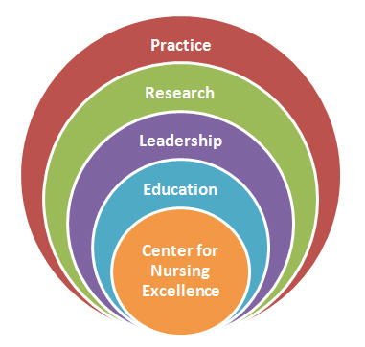
Center for Nursing Excellence
In accordance with the best international practice, the Center for Nursing Excellence (CNE) will be established.
1. Analysis of required
needs and requirements
2. Creation and development
of the Center and e-platform
3. Start and sustainable development of the Center
Literature review, experience sharing, trainings, Delphi research
Choice of platform and interface design, creation of a working group, master classes, selection and development of the optimal infrastructure of the Center
Pilot project, study of efficiency / convenience for users, sustainable development plan of the Center
The creation of the Center, which will combine practice, research and education in nursing, is innovative for Kazakhstan
The mission of CNE is to provide an environment to support outstanding evidence-based nursing practice, research, education, and leadership opportunities that promote excellence in professional nursing practice.

Slide 9
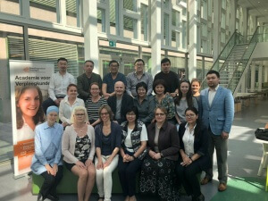
Master class in Groningen, Netherlands
From 16 to 20 April, 2018 in Groningen at the Hanze University of Applied Science
there was conducted the master class on creation of the Center for Nursing Excellence.
The main goal of the master class – to familiarize with the best practices in nursing for further design and development of the Center for Nursing Excellence in Kazakhstan.

Slide 10
WP 2.1. Examples of good practices
Country/region | Organisations | Internetadres
World wide | 1. International Council of Nurses (ICN) | http://www.icn.ch
 | 2. Sigma Global Nursing Excellence / Rho Chi | https://www.sigmanursing.org
 | 3. Acendio | http://www.acendio.net
Netherlands | 4. Vilans | https://www.vilans.nl
Finland | 5. Nursing Research Foundation HOTUS | http://www.hotus.fi
Kazakhstan | 6. Republic Public Association Specialists of Nursing Paryz | http://www.paryz.kz
Russia | 7. Public organization “Russian Nurses' Association” (RNA) | http://www.medsestre.ru

Slide 11
WP 2.2. Efficiency and quality by evidence based nursing
One of the main ideas in WP 2.2. is to build the capacity of all staff members that teach evidence based nursing regardless where are they employed.
Objective: study of the best experience in the implementation of evidence-based nursing in nursing research, education and practice.
As the primary activity of WP 2.2. the gap analysis on evidence based nursing, including the research on existing curriculum content and data content analysis, had been done. The gap analysis contains the overview of the existing curriculum content at bachelor and master degree in nursing, what revealed the implementation of research and evidence based nursing on curriculum. The identified gaps in evidence based nursing education are represented in the report of Gap analysis and will be used in composing of the national educational materials on evidence based nursing practice.

Slide 12
WP 2.3. Establish HEI research program and networking in nursing
Цель: Strengthen Medical Universities role in building evidence based nursing research activities in health services in order to promote the quality and safety of healthcare system.
2. Support the development of research agenda in nursing at the Medical Universities in Kazakhstan by learning from the international practices on nursing research development
3. Build the partnership between HEIs and healthcare facilities in nursing research
1. Support the development of nursing research infrastructure
4. Joint international research projects in nursing
Searching current nursing research infrastructure there was conducted the survey for HEIs via self-assessment questionnaires. The benchmarking report with recommendations for improving of infrastructure required for the research will be finalized on September, 2018.
In addition, focus group interviews for supporting the development of research agenda on nursing in Medical Universities will be conducted until the end of June.

Slide 13
WP 2.4. Modernization of nursing leadership
WP 2.4. was developed on the basis of the analysis of the needs for the development of nursing practice in Kazakhstan, as well as in cooperation between healthcare facilities and medical universities.
WP focused on three main points: :
Lack of a strong position and managerial role of the nurse in healthcare facilities of Kazakhstan;
Lack of modern skills in managing nursing staff in healthcare facilities in Kazakhstan;
Lack of cooperation between practical healthcare and the educational system in the field of modernization of nursing leadership and nursing practice.
Objective: strengthen the role and position of the nurse at the structural level, promote capacity of nursing leadership and management system.
For today, a survey on leadership competences for nurses and doctors on administrative positions has been completed. Altogether 250 respondents from 40 healthcare facilities of the Republic of Kazakhstan were interviewed. Analysis of the results and preparation of the report is planned from July to September 2018.

Slide 14
WP 4. Dissemination
Target Group | Ways
Ministry of Education and Science, Ministry of Health of the Republic of Kazakhstan Academic Society International Nursing Community Practical healthcare Patients and Society | Press Releases Web site Social network Blog Newsletters Conferences, meetings, master classes Reports / scientific publications Erasmus+ platform
The level of dissemination and implementation focused on: Awareness / education Action / participation Support

Slide 15
Dissemination of results
There were developed newsletters «ProInCa NEWS»,
leaflets in English and Russian languages
Join us:

Slide 16
Expected results
Sustainable mechanisms for collaboration and knowledge sharing between the national and international academic nursing community and society.
Increased relevance of nursing education for the labor market through the implementation of evidence-based nursing.
Strengthened role of Medical Universities in building evidence-based nursing research activities.
New sustainable system of nursing leadership and management in healthcare with collaboration of higher education institutions and healthcare facilities.

Slide 17
“Coming together is the beginning;
Keeping together is progress;
Working together is success”
Henry Ford

Slide 18
Thanks for your attention!

Slide 19
Databases:
Pubmed (eLibrary)
Embase
Cinahl
Trip
E-library
Research Librarian
http://proinca-nursing.kz/
https://www.facebook.com/proincanursing/
https://twitter.com/ProInCa_Nursing

